Slide 1
The Mental Health Care Patient Management System (Mentcare)
01234567890000123456789000123

Slide 2
Mentcare: A patient information system for mental health care
A patient information system to support mental health care is a medical information system that maintains information about patients suffering from mental health problems and the treatments that they have received.
Most mental health patients do not require dedicated hospital treatment but need to attend specialist clinics regularly where they can meet a doctor who has detailed knowledge of their problems.
To make it easier for patients to attend, these clinics are not just run in hospitals. They may also be held in local medical practices or community centres.

Slide 3
1) System overview :
Mentcare is an information system that is intended for use in clinics.
It makes use of a centralized database of patient information but has also been designed to run on a PC, so that it may be accessed and used from sites that do not have secure network connectivity.
When the local systems have secure network access, they use patient information in the database but they can download and use local copies of patient records when they are disconnected.
It is solely intended to support mental health care (e.g. if a patient is suffering from some other unrelated condition, such as high blood pressure, this would not be formally recorded in the system). The system must therefore interoperate with and shared information with other patient record systems that are in use.

Slide 4
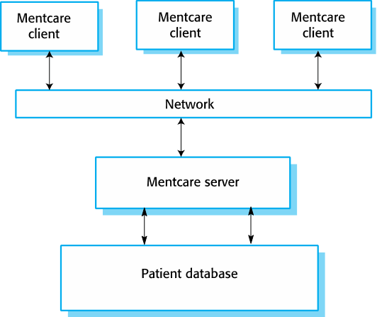

Slide 5
3) Mentcare goals:
To generate management information that allows health service managers to assess performance against local and government targets.
To provide medical staff with timely information to support the treatment of patients.
In a minority of cases, they may be a danger to themselves or to other people. They may regularly change address or may be homeless on a long-term or short-term basis. Where patients are dangerous, they may need to be “sectioned”—that is, confined to a secure hospital for treatment and observation.
To provide an improved records system for clinical staff involved in diagnosis and treatment and follow up on their condition.

Slide 6
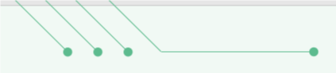


4) Key features of the Mentcare system:
Individual care management : Clinicians can create records for patients, edit the information in the system, view patient history, etc. The system supports data summaries so that doctors can quickly learn about the key problems and treatments that have been prescribed.
Patient monitoring : The system monitors the records of patients that are involved in treatment and issues warnings if possible problems are detected.
Managing involuntary detention : in a minority of cases, patients may be a danger to themselves or to other people. They may regularly change address and may be homeless on a long-term or short-term basis. Where patients are dangerous, they may need to be 'sectioned' – confined to a secure hospital for treatment and observation. The system must make provision for managing patients who have been detained and for ensuring that all required legal processes are followed and documented.
Administrative reporting : The system generates monthly management reports showing the number of patients treated at each clinic, the number of patients who have entered and left the care system, number of patients sectioned, the prescribed drugs and their costs, etc

Slide 7
6) System usability :
The Mentcare system will be used by a range of professional and administrative staff including senior doctors and consultants. For acceptance of the system by these staff, it is essential that close attention is paid to system usability so that users
can learn to use the system quickly;
(b) can use the system without undue effort during a patient consultation and
(c) make as few errors as possible when using the system.
5)Users:
Users of the system include clinical staff such as doctors, nurses, and health visitors (nurses who visit people at home to check on their treatment). Nonmedical users include receptionists who make appointments, medical records staff who maintain the records system, and administrative staff who generate reports.

Slide 8
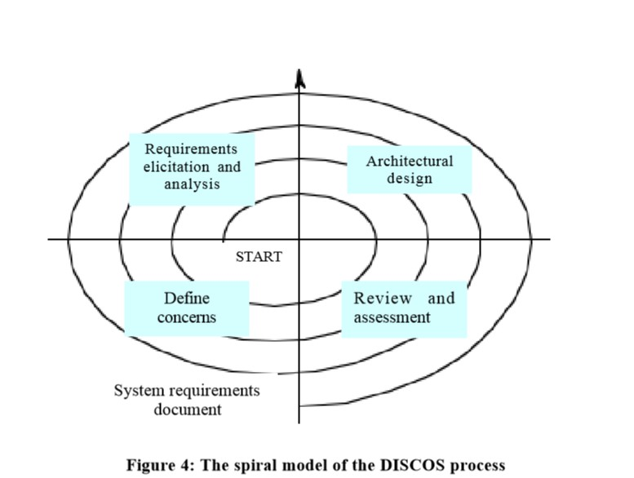
8)In the system, we have identified the principal concerns as:
1. Safety – the system should help to reduce the number of occasions where patients cause harm to themselves or others. The system must be available when needed otherwise safety may be compromised and it may be impossible to prescribe the correct medication to patients.
2. PrivacyIt - is essential that patient information is confidential and is never disclosed to anyone apart from authorised medical staff and the patient themselves.
3. Operational costs – the operational costs of the system must be ‘reasonable’.
4. Information quality and cost– the information maintained by the system must be accurate and up-to-date.
Notes:
السلامة تتسبب بعض الأمراض العقلية في أن يصبح المرضى قادرين على الانتحار أو يشكلون خطراً على الآخرين. حيثما كان ذلك ممكنًا ، يجب أن يحذر النظام الطاقم الطبي من المرضى الذين يحتمل أن يكونوا انتحاريين أو خطرين. يجب أن يكون النظام متاحًا عند الحاجة وإلا قد تتعرض السلامة للخطر وقد يكون من المستحيل وصف الدواء الصحيح للمرضى.

Slide 9
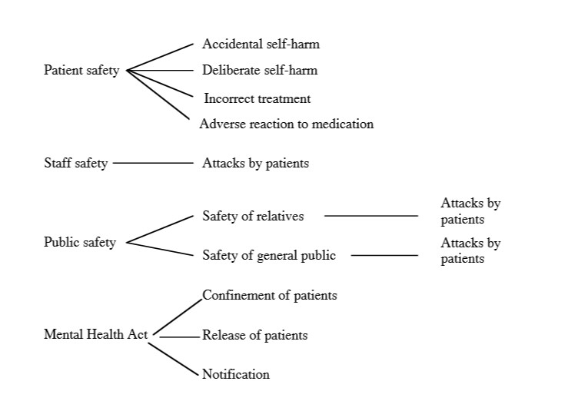

Slide 10
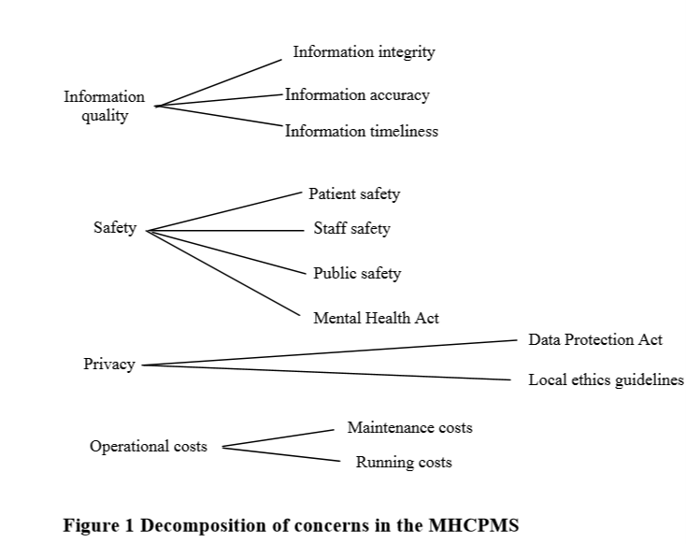

Slide 11
9) Mentcare System requirements:
System requirements:
. User requirements
Security and Safety requirements
Availability requirements
Response requirements
Data exchange requirements
Clinical requirements
Management requirements
Administrator requirements

Slide 12
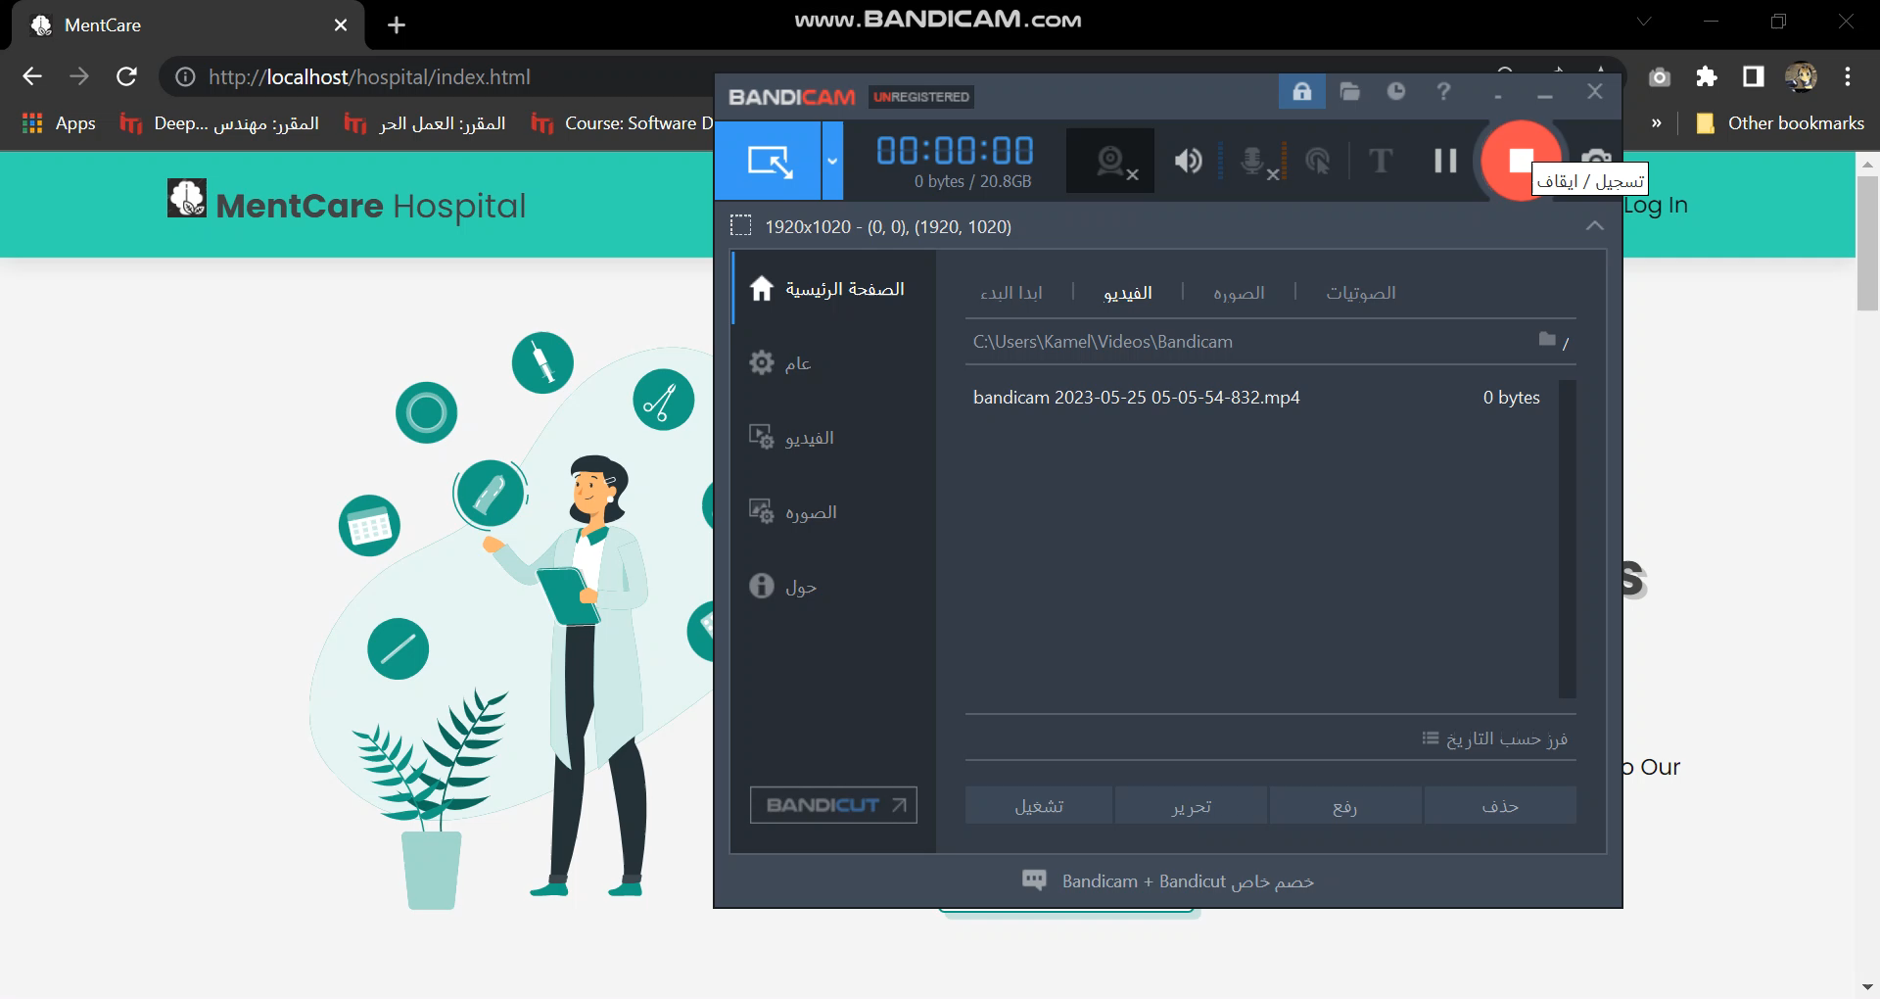

Slide 13
Prepared by:
Sarah Nabil Kamel .
Shaima Ahmed .
Esraa Mohammed Abu Al-Wafa .
Ebtihal Abdel Moneim .
Fatima Abdel Samad .
Hadeer Abel El-Nasser

